Slide 1
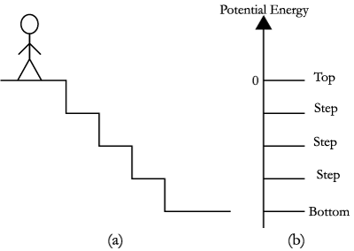
Peer Assessment
Self Assessment
Team Assessment
Weighting Factor = √(PA)⁄(Average of PA)

Slide 2
Peer Assessment
Construct | Peer Assessment Reflection | Very Poor | Below Average | Average | Above Average | Excellent
Preparation | How well were " " prepared when " " came to class?
Attendance | How well did " " attend the group meetings?
Contribution | How well did " " conribute productivitively to the team discussion and work?
Respect for others' ideas | How well did " " encourage others to contribute their ideas?
Flexibility | How well were " " flexible when disagreements occurred?
Describe One Positive Feedback | Tell " " one thing he/she does well, which helps to make your team more effective. Please address him/her directly using the second person (“you”). The text you enter below will anonymously be transmitted to " ".
Describe One Constructive Suggestion | Give " " one constructive suggestion to help him/her become a more effective part of the team. Please address him/her directly using the second person (“you”). The text you enter below will anonymously be transmitted to " ".
Self Assessment
Construct | Self Assessment Reflection | Very Poor | Below Average | Average | Above Average | Excellent
Preparation | How well were you prepared when you came to class?
Attendance | How well did you attend the group meeting?
Contribution | How well did you conribute productivitively to the team discussion and work?
Respect for others' ideas | How well did you encourage others to contribute their ideas?
Flexibility | How well were you flexible when disagreements occurred?
Team Assessment
Construct | Team Assessment Reflection | Very Poor | Poor | Acceptable | Good | Very Good
Communication | How would you rate your team's ability to communicate effectively with team members?
Interdependence | How would you rate your ability to depend upon your teammates?
Commitment to team success or shared goals | How would you rate your team's level of commitment to a shared goal?
Distribution | How would you rate the clarity and distribution of roles on your team?
Productivity | How would you rate your team's ability to work effectively and efficiently together?
Describe One Positive Feedback | Tell one thing your team does well.

Slide 3
Report for Student
Part 1. PA
Diagram
Comments from PA
Part 2. TA
Diagram
Comments from TA

Slide 4
Report for Instructor
 |  | Average of PA(Individual) | Average of PA(Group) | Average of SA | Weight Factor
Team 1 | Student 1 | 4.2 | 3.1 | 1.2
Average of Team Assessment | Student 2
 | Student 3
 | Student 4
 | Student 5
Team 2 | Student 1
Average of Team Assessment | Student 2
 | Student 3
 | Student 4
 | Student 5
Team 3 | Student 1
Average of Team Assessment | Student 2
 | Student 3
 | Student 4
 | Student 5
Diagram

